Slide 1
Assessment 2
ADAD3402 Interactive Generative Visualisations
z5158177
Yicheng PAN

Slide 2
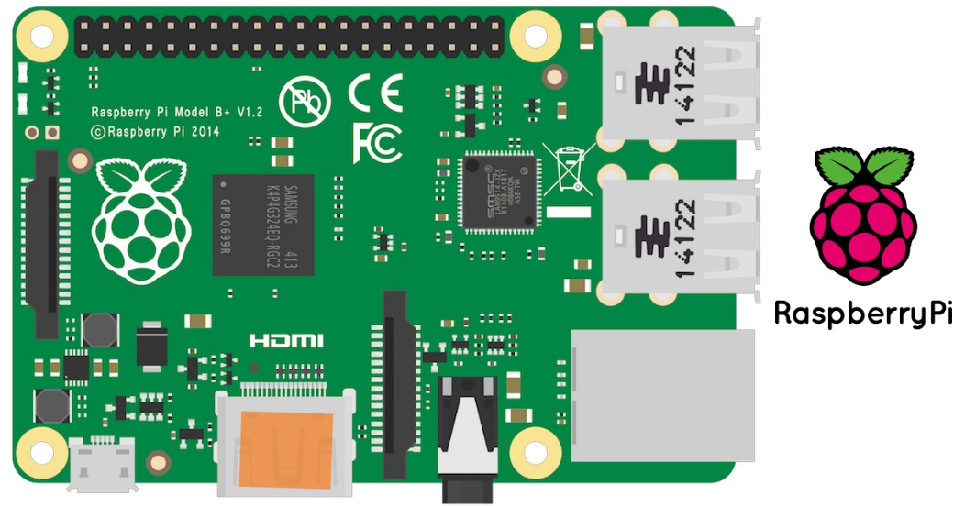
The Concept
Use the raspberry pie and camera to simulate the effect of the mirror on the screen and increase the interactivity, so that the viewer can get feedback on the graphics and sound effects while touching the mirror.

Slide 3
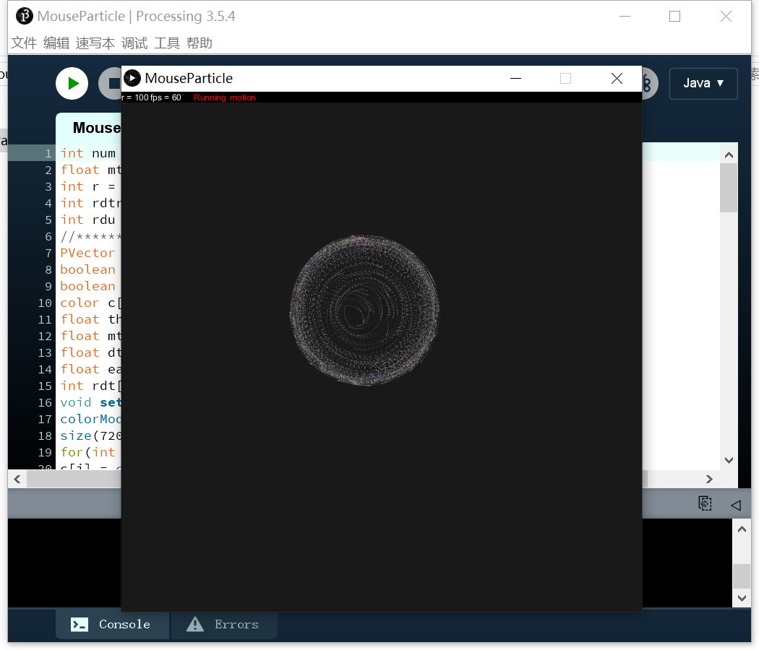
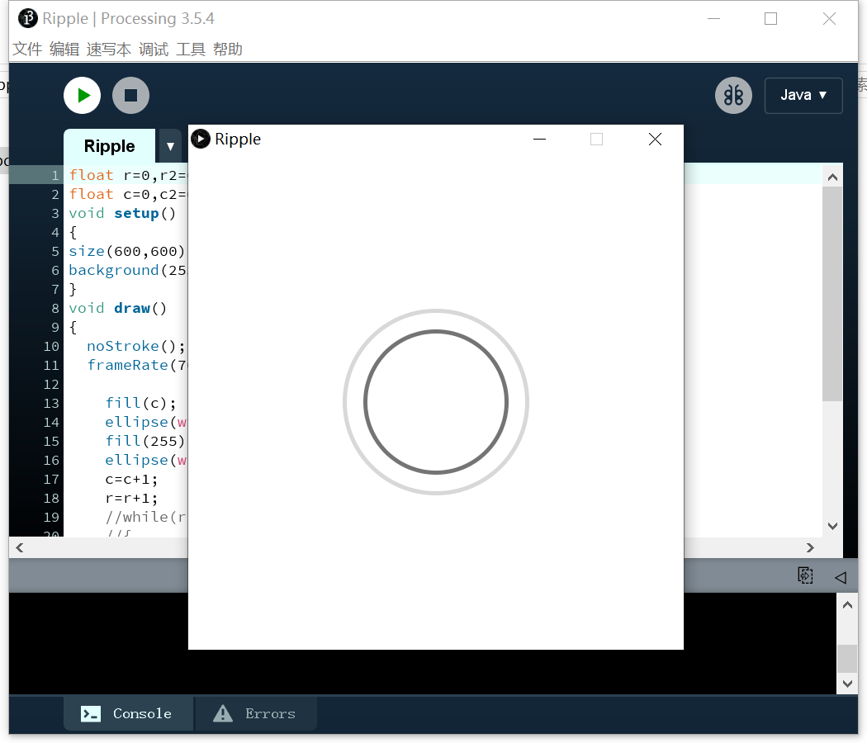
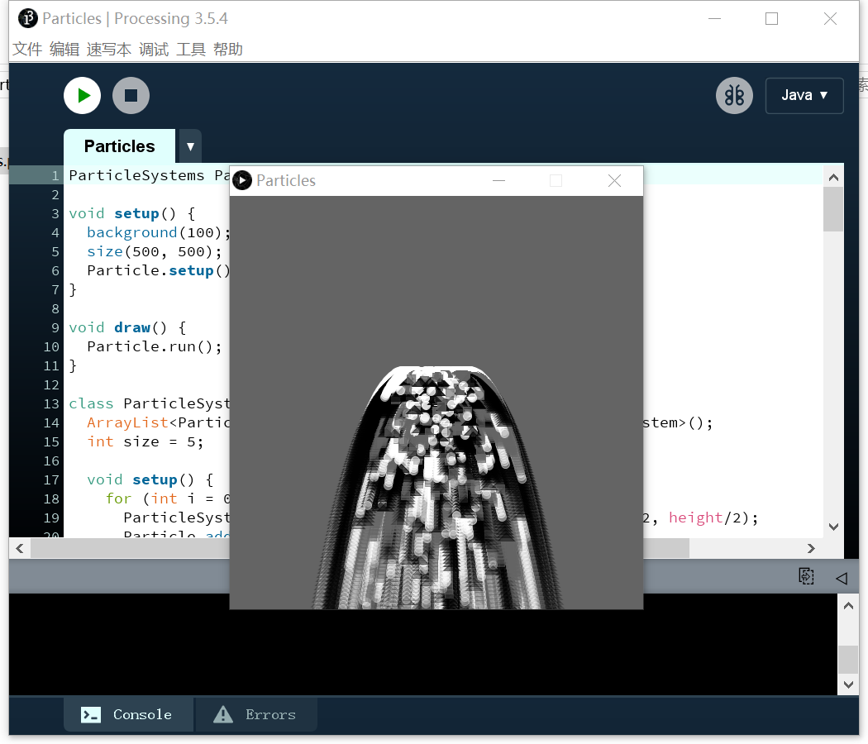
Interaction principle
The particle dynamic effect will automatically play in a loop without physical touch
After sensing the touch operation, the screen will fade out to the mirror mode
More interactive effects can be reflected in different touch schemes

Slide 4
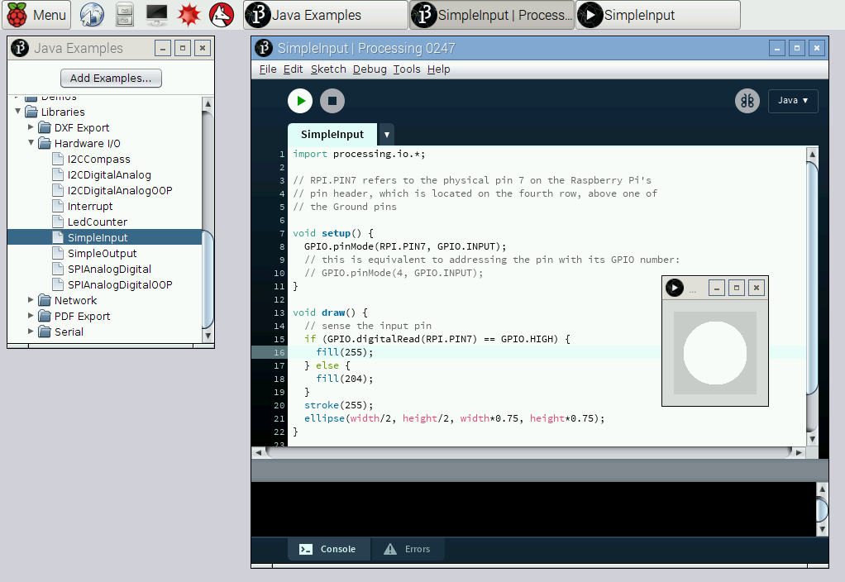
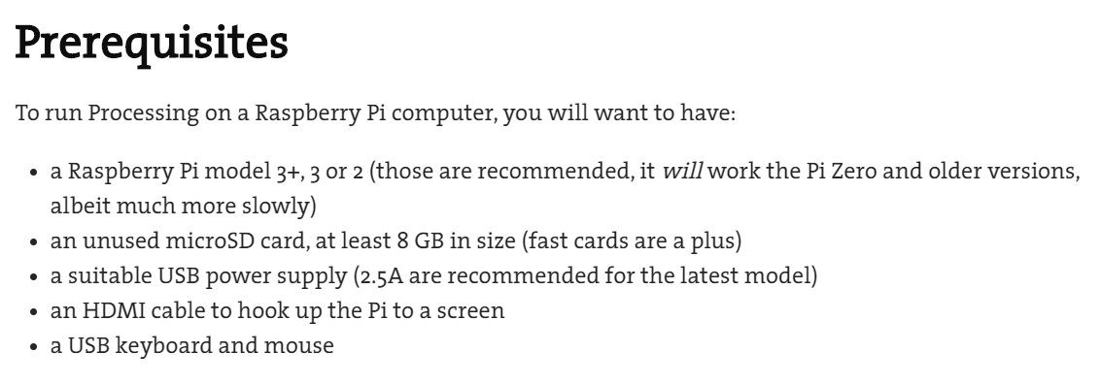
Interaction principle
The best solution to use Processing 3 on the Raspberry Pi is to directly flash the Raspberry Pi system that has embedded the complete Processing 3 program, which can be found on the official website, but the installation is a bit troublesome.

Slide 5
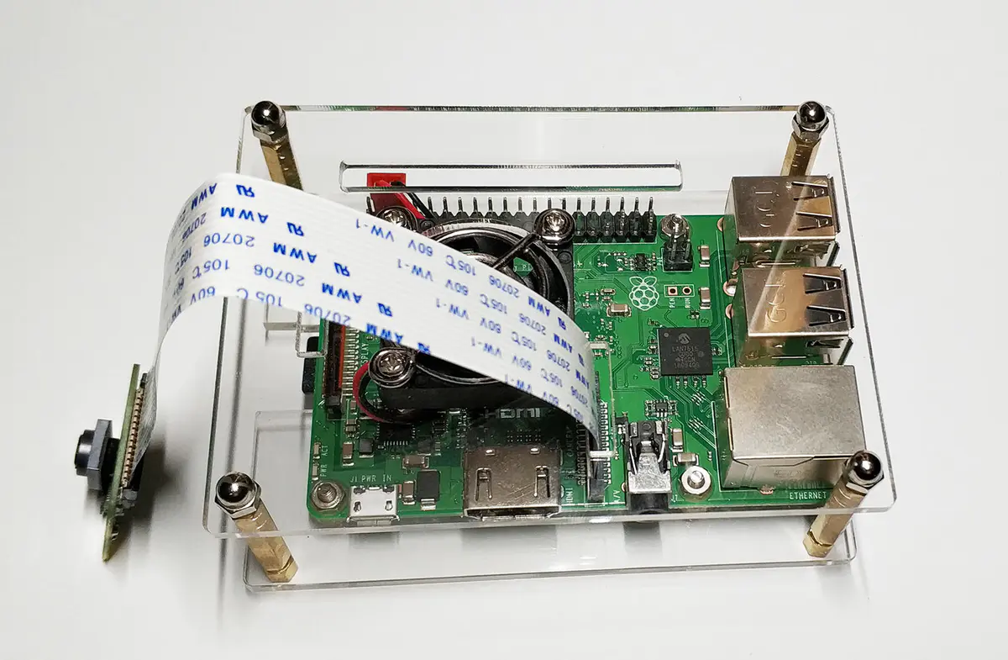
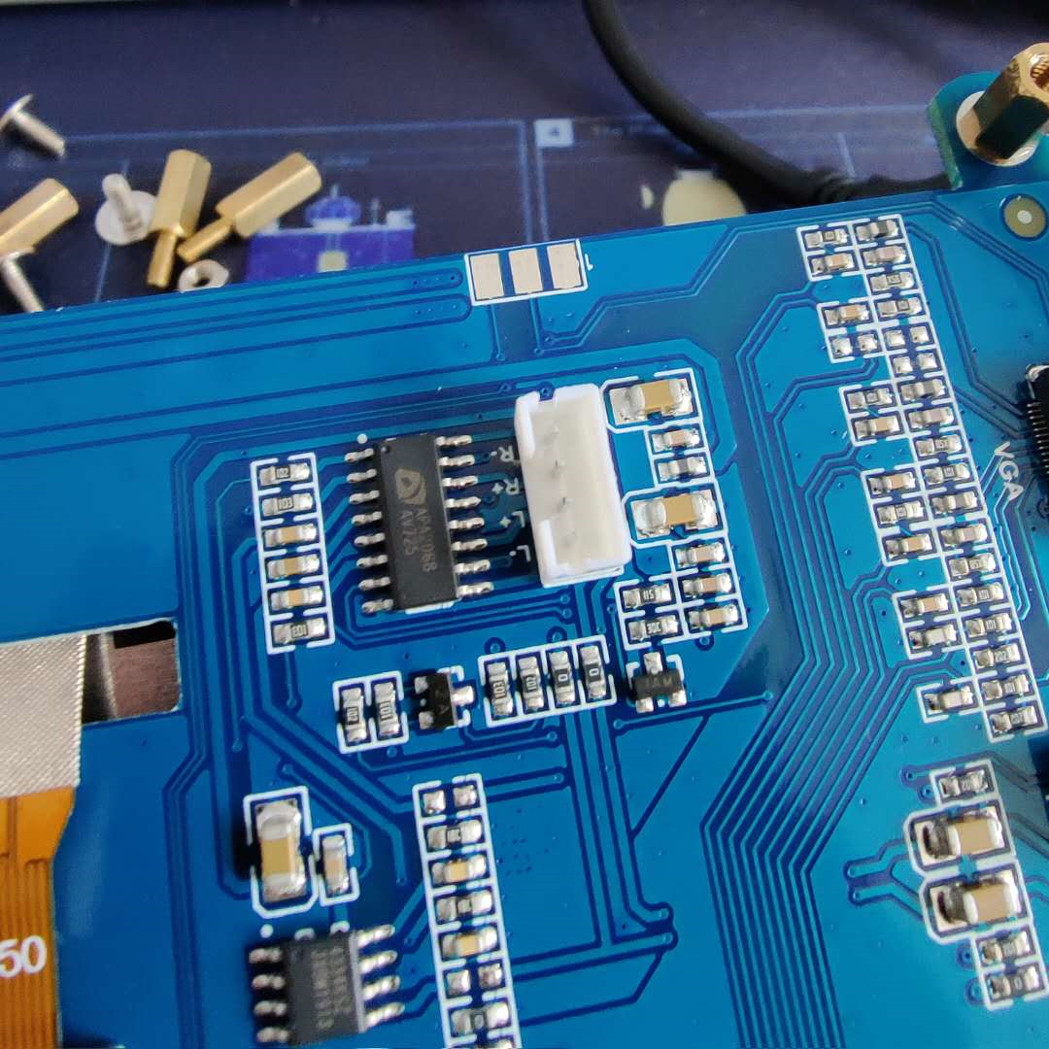
Interaction Scenario
The speaker interface is a specific 4-pin interface, which is rare in the market, so it has not been received yet.
The camera uses a cable to directly connect to the motherboard, but you need to load the driver yourself into the Processing 3 program folder and debug it.

Slide 6
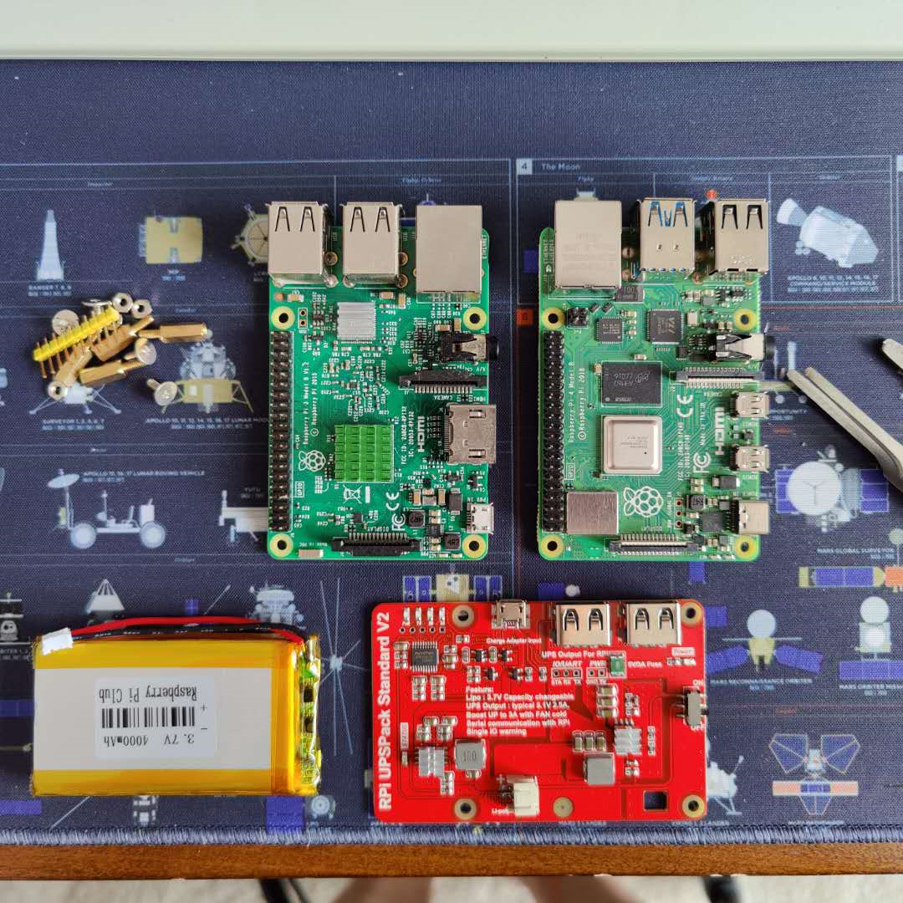
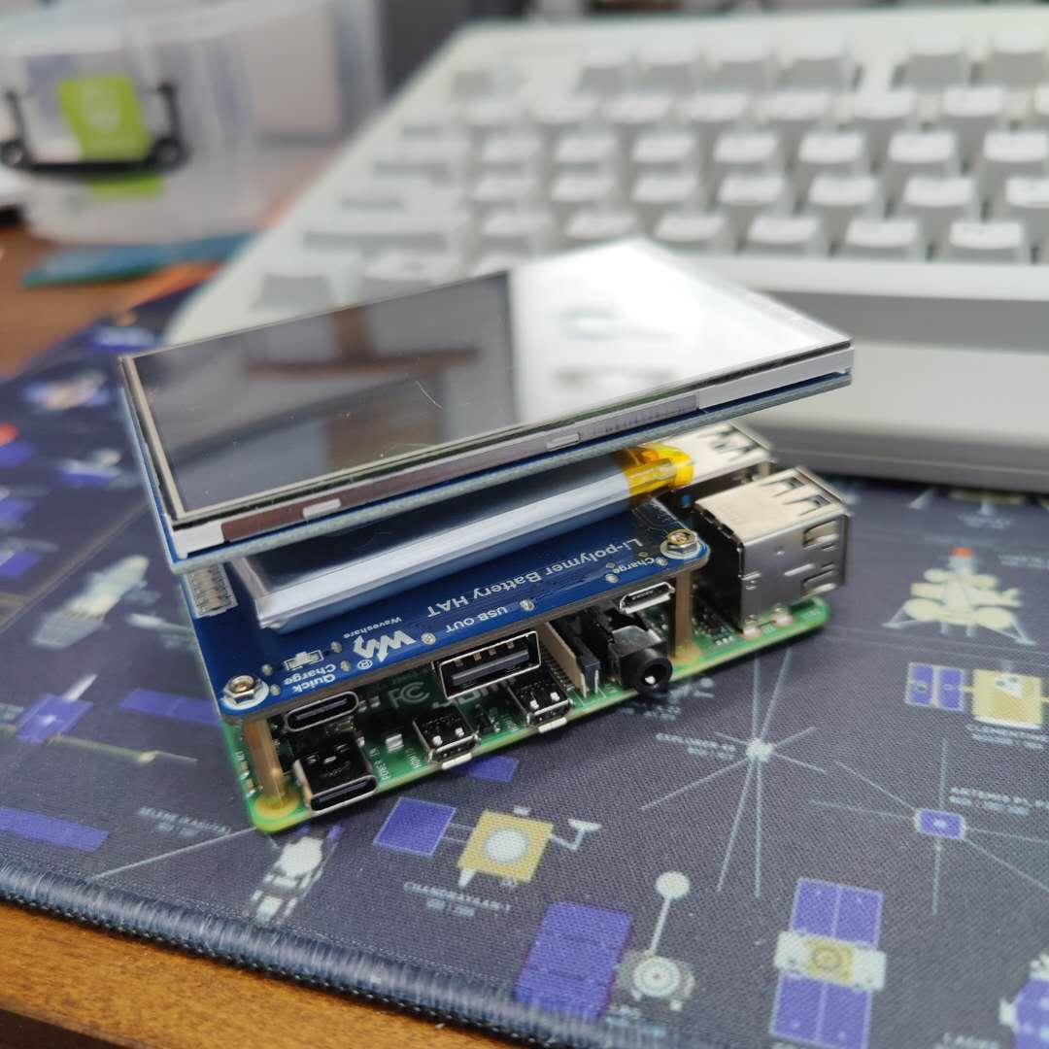
Interaction Scenario
Compared two different motherboard and battery solutions. Raspberry Pi 4B has excellent performance but overflows and consumes a lot of power, which will burden the screen and camera and accelerate power consumption. Raspberry Pi 3B is efficient and power-saving, has better adaptability to the camera and touch driver, and has a variety of power supply solutions.

Slide 7
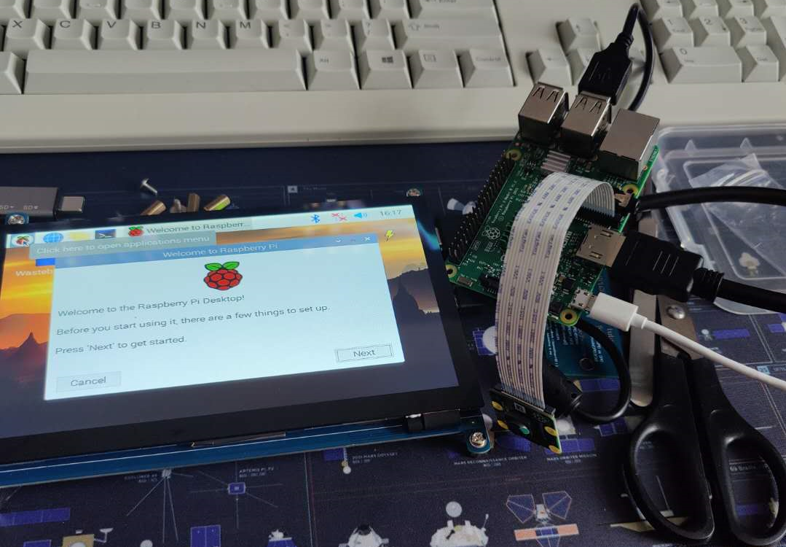
Interaction Scenario
For system adaptation, more debugging is needed, and the resolution of the connected screen needs more debugging to achieve compatibility with the program. The camera and motherboard need to be fixed behind the screen. For aesthetics, the periphery of the screen and the motherboard can be surrounded and covered and made into a whole to ensure that the interface is exposed. Pressed wood boards that are easy to cut and sand become the primary material. The wire used for the connection should also be taken into consideration.

Slide 8
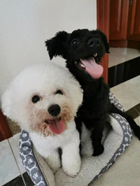
Production Timeline
Jun 1 - Jun 4
Installation Proposal
Jun 8 - Jun 16
Connect Raspberry Pi
Jun 15 - Jul 5
Write the main program and graphical interface
Jul 1 - Jul 11
Test program and hardware interaction
Jul 20 - Jul 27
Debug
Final improvements and adjustments
Jul 1 - Jul 29
Record interactions and submit
Jun 27 - Jul 29
Start Date
Due Date
Jun 1
Jul 29
2020
Today
May
June
July
2020

Slide 9
THANKS
z5158177
Yicheng PAN

